Slide 1
TASK FORCE MEETING 3.5.2021
Notes:
Justice Earls

Slide 2
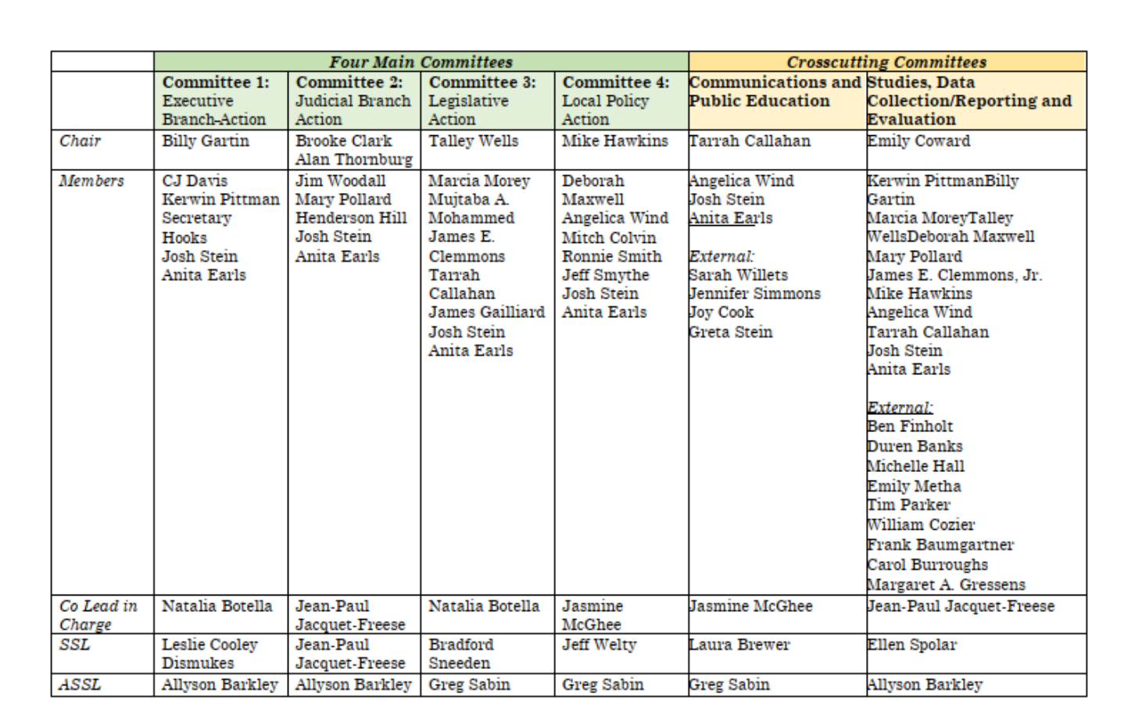
AMENDMENTS
Notes:
Justice Earls

Slide 3
Committee #1: EXECUTIVE BRANCH
Notes:
NCCJ

Slide 4
Primary Recommendations – Bucket Groups
Committee #1
Bucket | Description
Training | Consider how to add training to current curricula in several areas to include implicit bias, CIT, racial equity, SRO, community policing, and protest demonstration. Evaluate current training for BLET, working with partners at JA and Commissions.
Policy | Addiction as a public health crisis, early intervention, protest policies, use of force, response to individuals with mental illness.
Commission Action | Present suggestions to Commissions for revision of minimum standards and power of suspension/revocation/denial. Request new rules for use of force, psych exams, transparency, and notification to Commissions of certain issues. Support NCLEA. Request Commissions consider diversity issues.
Clemency | Promote a Juvenile Review Board to make clemency recommendations. Secure increased funding for Governor’s Clemency Office and Parole Commission.
Prisons | Work with DPS on policies to address flexibility of release dates, increased services for incarcerated persons, transforming use of restrictive housing.
Recruitment/Retention | Work with stakeholders to draft best practices policy to aid agencies.

Slide 5
Primary Recommendations – Policy Bucket
Committee #1
Recommendation | Next Steps
Rec 17: Treat addiction as a public health crisis, including substance use addictions that disproportionately impact Black and brown communities, such as crack cocaine. | Host panel discussion to continue conversation. Explore how treatment courts have tracked and reported on equity.
Rec 25: Support Task Force on Safer Schools State Action Plan. | DPS is currently working on this. TREC will monitor and report on progress.
Rec 28: Create and update protest guidelines to consider best practices and First Amendment concerns. | Collect existing policies from various agencies and see where those policies align with each other and where there may be missing concepts that need to be implemented. Consider best practices across the country. Identify most important concepts in protest response. Draft sample policy by looking at collected policies and other literature. Check on NCLEA accreditation process and CALEA guidelines.
Rec 34: Establish early intervention systems for officers repeatedly violating use of force policies. (See also Rec 31 re: use of force policies, Secondary Responsibility) | Gather existing policies from select agencies. Draft sample policy based upon expert input and collected policies. Partner with agencies who don’t have policies to draft and implement. Check on NCLEA accreditation process and CALEA guidelines.

Slide 6
Committee #2: JUDICIAL BRANCH
Notes:
NCCJ

Slide 7
Primary Recommendations – Judicial Stakeholders Bucket
Committee #2
Immediate Prioritization
Recommendation ​ | Strategy
Rec. 24: Encourage School Justice Partnerships to reduce students’ juvenile court involvement ​ ​ | Generate buy-in from key judicial stakeholders Research models already implemented statewide and collect data Advocacy push in conjunction with Youth Justice Awareness Month in October Facilitate creation of School Justice Partnerships in every county ​
Rec. 91: Increase representation of North Carolinians serving on juries through expanded and more frequent sourcing, data transparency, and compensation ​ Rec. 93: Provide implicit bias training to all jury system actors ​ Rec. 94: Establish a state commission on the jury system, with an eye toward comprehensive reform ​ | Support development of methods to mitigate implicit bias on juries and to ensure that juries represent the state’s diversity, including (1) procedures to bring jury pools in line with the make-up of a community, (2) videos/trainings for juries aimed at mitigating implicit bias, and (3) more robust data collection and study of jury list formation and removals, racial equity, peremptory strikes, and accessibility of juror pool software. ​ Generate buy-in from key judicial stakeholders ​

Slide 8
Primary Recommendations – Judicial Stakeholders Bucket
Committee #2
Immediate Prioritization
Recommendation | Strategy
Recs 79-83: Bail/pre-trial reform ​ | Generate buy-in from key judicial stakeholders Spread awareness to ensure that local judicial officials feel supported during local implementation ​ ​
Rec. 104: Develop a process to eliminate criminal justice debt ​ ​ | Identify existing processes and organizing slate of recommendations Connect with experts at SOG and in other jurisdictions

Slide 9
Primary Recommendations – Judicial Stakeholders Bucket
Committee #2
Ongoing Efforts
Recommendation | Strategy
Rec 84: Require racial equity training for court system personnel, including judges, DAs, and public defenders | Work with SOG to develop training and then connect with judicial conferences, Conference of DAs, IDS to generate buy-in. Engage AOC to consider creating standardized requirement. In the interim, support current proposal for a CLE requirement.
Rec 88: Enhance prosecutors’ data collection, technology, training opportunities, and staffing | Identify data needs and best practices through Data Committee and then work with the Conference of DAs on implementation Develop framework for data collection on charging decisions, including status offenses and felony plea offers Engage AOC as appropriate to strategize on data-housing
101: Assess a defendant’s ability to pay prior to levying any fines and fees | Review existing forms and research utilization in districts across the state Work with stakeholders to modify existing forms when necessary Research model deployed in Mecklenburg and elsewhere for assessing ability to pay

Slide 10
Primary Recommendations – Prosecutorial Stakeholder Bucket
Committee #2
Immediate Prioritization
Recommendation | Strategy
Rec 84: Require racial equity training for court system personnel, including judges, DAs, and public defenders | Work with SoG and CODA to create and expand racial equity training offerings Draft and distribute pledge to train
Rec 87: Educate prosecutors, their staff, and officers of justice on unconscious bias in the criminal justice process and prosecutorial decision-making | Develop understanding of authority of relevant stakeholders to mandate training Work with CoDAs to create unconscious bias training program
Rec 89: Study and adopt evidence-based reforms for reducing and eventually eliminating racial disparities in charging decisions and prosecutorial outcomes | Research progress in Orange County progress Develop education campaign aimed at encouraging local prosecutors to adopt reforms Explore partnership with local policy committee to work on grant funding
Rec 90: Establish working groups led by district attorneys to review and approve every habitual felony charging decision | Work with CoDAs to identify and develop a model to be used across all districts in NC

Slide 11
Primary Recommendations – Prosecutorial Stakeholder Bucket
Committee #2
Ongoing Efforts
​Recommendation ​ | Strategy ​
101: Assess a defendant’s ability to pay prior to levying any fines and fees | Review Mecklenburg bench card implementation Connect with SoG about status of their work
104: Develop a process to eliminate criminal justice debt | Identify existing processes and national models Organize slate of recommendations.
Rec 112: Eliminate the future use of Violent Habitual Felony Status | Collect data on pre- and post-reform habitual felon status (possible partnership with Data Committee)
Rec 113: Eliminate future use of Habitual Felony Status for individuals under the age of 21 or convicted of non-violent drug offenses
Rec 114: Amend the habitual felony statute to limit the “look back” period to within 8 years of the charged offense
Rec 116: Review all future sentences after 20 years or before | Research existing models, including state and federal legislative efforts

Slide 12
Primary Recommendations – Referrals to Data and Communications
Committee #2
Data, Studies, and Evaluation
  Rec 88: Enhance prosecutors’ data collection, technology, training opportunities, and staffing
  Rec 115: Analyze and report on racial disparities in sentencing laws and recommend possible changes
Communications and Public Education
  Rec 97: Establish a Second Look Act to reduce racially disparate sentences through the review and action of those currently incarcerated
  Rec 111: Broaden the use of Advanced Supervised Release
  Rec 117: Prohibit capital punishment for people with serious mental illness and people 21 or younger at the time of the offense and prohibit the use of juvenile adjudications to be considered as aggravating factors

Slide 13
Committee #3: LEGISLATIVE ACTION
Notes:
NCCJ

Slide 14
Committee #4: LOCAL POLICY ACTION
Notes:
NCCJ

Slide 15
Primary Recommendations
Committee #4 – Overview of Process to Date
Reviewed and discussed assigned recommendations
  Referred several to data and communications committees
  Surveyed police chiefs and sheriffs regarding co-responder/alternative responder programs
Identified next steps and stakeholders for remaining recommendations
Decided to put in "buckets" by single most important stakeholder
Polled group to begin prioritization within buckets

Slide 16
Primary Recommendations
Committee #4 – Data and Communications Referrals
Data:
Rec 11: Use data and objective criteria, instead of officers' subjective perceptions and beliefs, to drive the level of police presence in neighborhoods
Rec 15: Restrict state law enforcement use of asset forfeiture on low-level seizures where there is no conviction
Communications:
Rec 61: Establish and fund restorative justice programs in local communities across the state and at various points of the criminal justice system
Rec 62: Form a victim advisory group to help develop restorative justice programs and other equity programs for crime victims

Slide 17
Primary Recommendations
Committee #4 – Stakeholder Buckets
Law Enforcement – Agency Heads; Chiefs Association; Sheriffs Association
Rec 6: Adopt community policing philosophies and plans in collaboration with the communities law enforcement serves
  Also in victims/community bucket
Rec 8: Encourage or require officers to spend non-enforcement time, or live in, the neighborhoods they serve
Rec 9: Publicly acknowledge mistakes by law enforcement to build trust and transparency
Rec 11: Use data and objective criteria, instead of officers' subjective perceptions and beliefs, to drive the level of police presence in neighborhoods
  With data team for questions
Rec 12: Deemphasize felony drug possession arrests for trace quantities under .25 grams
  Judicial committee will approach this with and through the DAs
Rec 13: Prioritize traffic stops that improve traffic safety
Rec 14: Require all consent searches to be based on written, informed consent
Rec 18: Encourage citations and summons in lieu of arrest whenever possible
Rec 21: Develop inclusive processes for selecting and overseeing SROs
  Also in victims/community bucket
Rec 71: Deprioritize marijuana-related arrests and prosecution

Slide 18
Primary Recommendations
Committee #4 – Stakeholder Buckets
Local Government – City Councils; League of Municipalities; County Commissions; Association of County Commissioners; Association of Local Health Departments
Rec 1: Respond more appropriately to situations concerning mental illness, autism, intellectual disabilities, substance abuse, homelessness, and other non-emergency situations
Rec 3: Fund grassroots organizations that employ promising and peaceful strategies to help communities promote public safety
Rec 5: Form local Community Safety and Wellness Task Forces to examine public safety and wellness needs
  Also in victims/community bucket
Rec 16: Establish and expand access to diversion programs
  Judicial committee will approach this with and through the DAs
Rec 19: Hire behavioral health professionals in schools
Rec 20: Fund school personnel training on mental health, first aid, cultural competence/diversity/inclusion, and developmental disability
Rec 83: Create independent pretrial services and improve data collection

Slide 19
Primary Recommendations
Committee #4 – Stakeholder Buckets
Victims/Community Voices & Organizations – United Way; National Association of Social Workers; NC CRED; NC CASA; Our Voice; NC VAN; Forward Justice; PTAs
Rec 4: Develop and provide funding to help communities build violence prevention programs
Rec 6: Adopt community policing philosophies and plans in collaboration with the communities law enforcement serves
  Also in law enforcement bucket
Rec 21: Develop inclusive processes for selecting and overseeing SROs
  Also in law enforcement bucket
Rec 61: Establish and fund restorative justice programs in local communities across the state and at various points of the criminal justice system
Rec 62: Form a victim advisory group to help develop restorative justice programs and other equity programs for crime victims
Rec 5: Form local Community Safety and Wellness Task Forces to examine public safety and wellness needs
  Also in local government bucket

Slide 20
Primary Recommendations
Committee #4 – Stakeholder Buckets
Grantmakers
Rec 1: Respond more appropriately to situations concerning mental illness, autism, intellectual disabilities, substance abuse, homelessness, and other non-emergency situations (local government)
Rec 3: Fund grassroots organizations that employ promising and peaceful strategies to help communities promote public safety (local government)
Rec 4: Develop and provide funding to help communities build violence prevention programs (victims/community)
Rec 61: Establish and fund restorative justice programs in local communities across the state and at various points of the criminal justice system (victims/community)

Slide 21
Primary Recommendations
Committee #4 – Survey of Police Chiefs and Sheriffs
Survey sent to police chiefs this week by CJ Standards and Sheriffs' Standards
  Closes today, so these are interim results
Asked about:
  Prevalence co-responder models, alternate responder models
  Successes of current programs
  Barriers to starting these programs
As of yesterday afternoon, we received responses from 240 law enforcement agencies in 80 counties across North Carolina
  36 Have a co-responder or alternative responder program
    26 more are planning to start one
    162 want to learn more about these programs
  42 have a specially-trained crisis response unit
    35 would prefer to have more officers trained for their unit

