Slide 1


Criminal Justice Data Partnership
Data Division
Government Data Analytics Center
Carol Burroughs
Analytics Director
Governor’s Crime Commission
Criminal Justice Analysis Center
Tim Parker
July 30, 2021

Slide 2
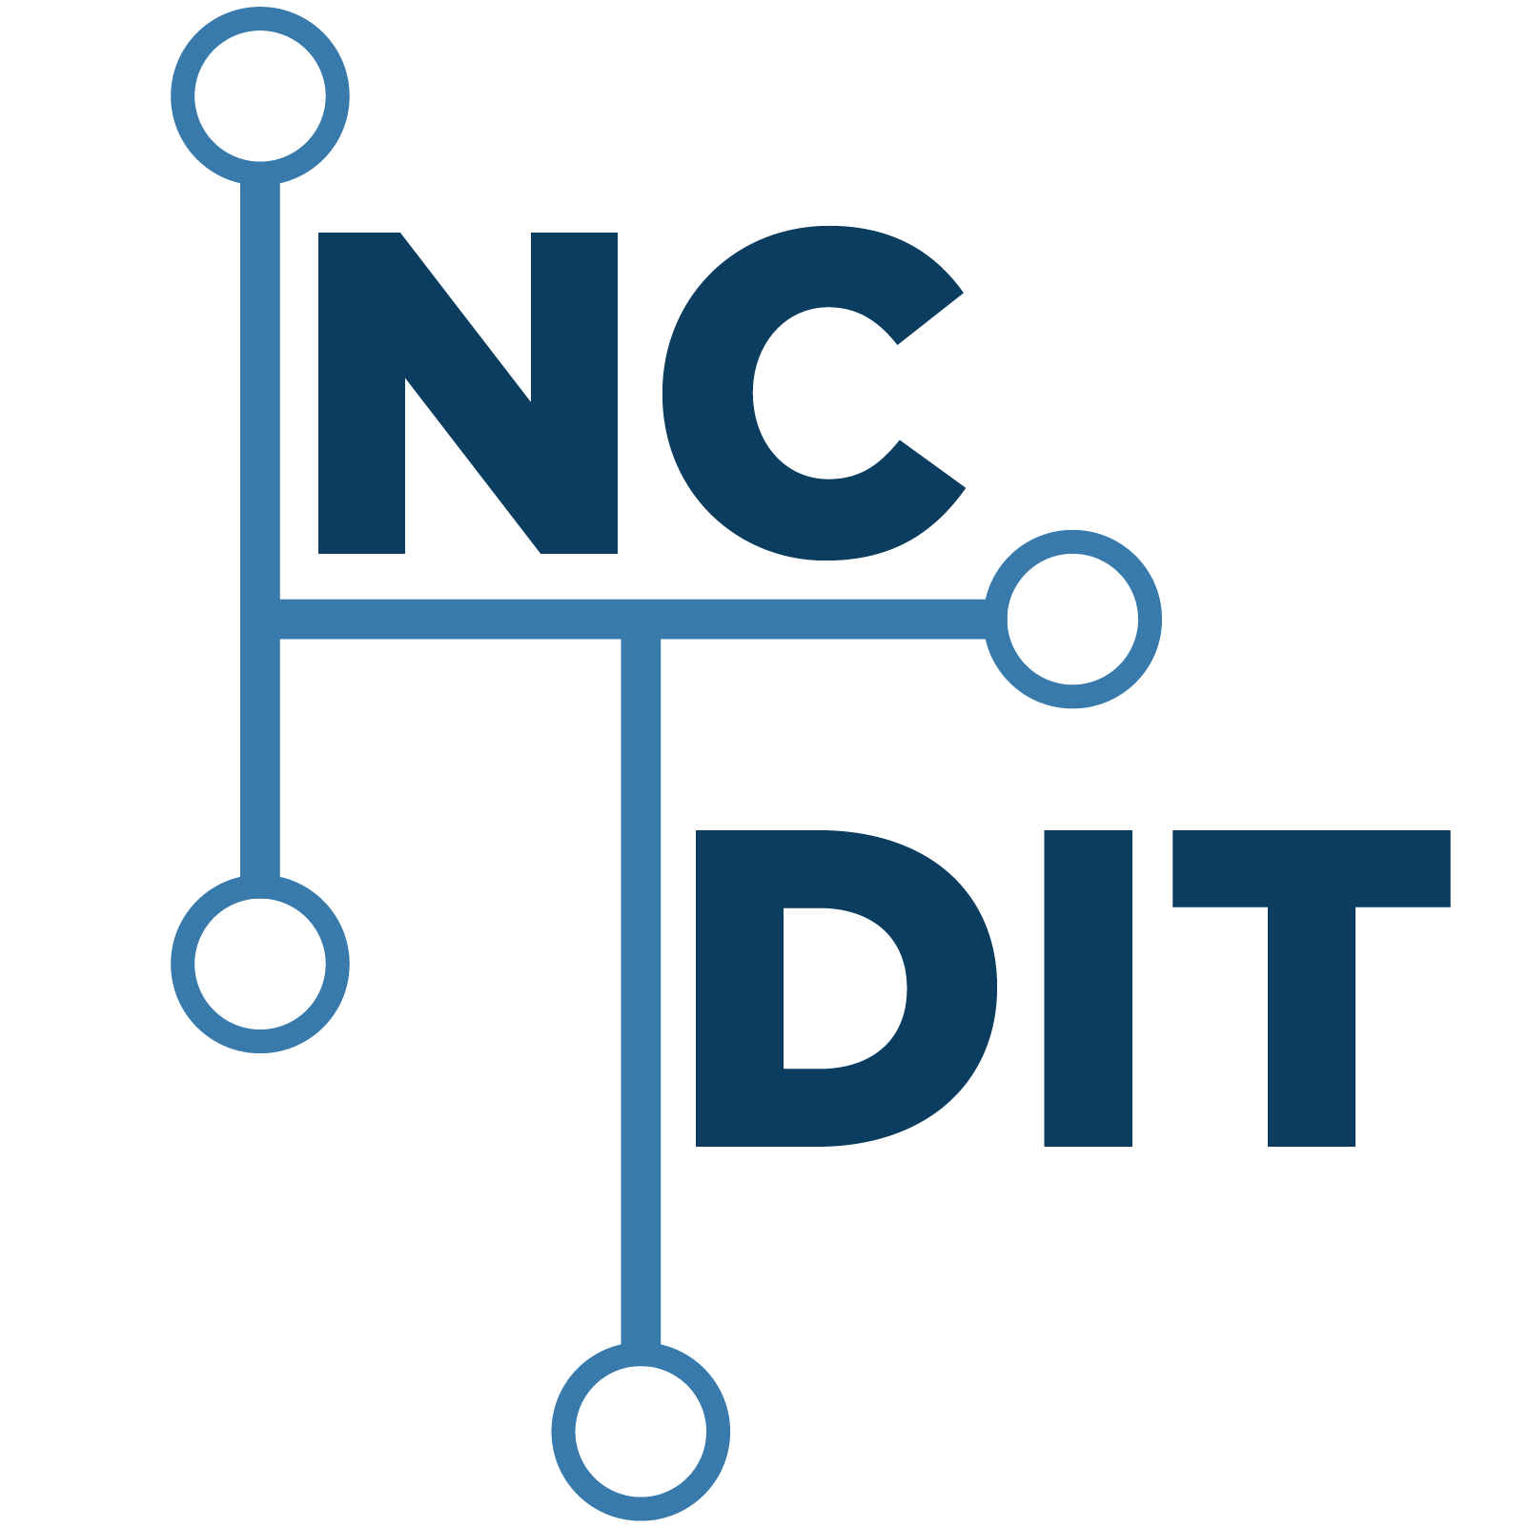
Data Division/Government Data Analytics Center
Chief Data Office
Vision
Trusted partner and leader for enabling the sharing of data assets
Mission
Transform data into information to facilitate decision support, increase operational efficiencies, and improve outcomes for the citizens of North Carolina by integrating and sharing data assets
N.C. G.S. 143B-1385
GDAC - Manage and coordinate enterprise data integration efforts
Notes:
The GDAC supports the integration and transformation of data into information for decision making.
Vision
Trusted partner and leader for enabling the sharing of data assets
Mission
Transform data into information to facilitate decision support, increase operational efficiencies, and improve outcomes for the citizens of North Carolina by integrating and sharing data assets.
As a data driven agency, we align with master data management principles while accounting for Government program and practices. For example: Citizen Centric services does not require having a “golden record” for an individual – rather it focuses on ensuring records across the disparate government systems can be linked, where appropriate.

Slide 3





Analytic Solution Delivery
Areas of Focus
Health
Criminal Justice and Child Safety
Financial and Transparency
Fraud and Compliance
Longitudinal and Performance
Notes:
The GDAC has been fortunate that both the Legislature and the Governor recognize the importance of the use of data to improve decision making and measuring the effectiveness of programs/polices. Following this presentation, I will share with you links to General Statues which support and enable our ability to integrate and share data.
The GDAC portfolio is aligned within the following domains
health, criminal justice, financial transparency, fraud/compliance, and longitudinal performance.
As a result of this alignment, the GDAC team has become well versed in the domain business and data structures. This knowledge base has become invaluable in the development and integration of the State’s administrative data.

Slide 4
Criminal Justice Analytics
Data Governance
Data Stewards/Custodians define
  Data classification
  Data access
  Data use
Infrastructure Controls – GDAC capabilities
  Environment – CJIS standards/controls
  Audit - Records access tracking
User Access Management
    Role based security
    Multifactor Authentication (MFA)
Notes:
The GDAC has been fortunate that both the Legislature and the Governor recognize the importance of the use of data to improve decision making and measuring the effectiveness of programs/polices. Following this presentation, I will share with you links to General Statues which support and enable our ability to integrate and share data.
The GDAC portfolio is aligned within the following domains
health, criminal justice, financial transparency, fraud/compliance, and longitudinal performance.
As a result of this alignment, the GDAC team has become well versed in the domain business and data structures. This knowledge base has become invaluable in the development and integration of the State’s administrative data.

Slide 5
Criminal Justice Analytics
Analytic Solutions
Criminal Justice Automated Data Services (CJLEADS) – Integrated offender records
National Instant Criminal Background Check System (NICS) Reporting
Sex Offender Compliance Alerts
Crime Lab and Court Record Integration Reporting
Recidivism Longitudinal Analysis
Investigative Case Management Systems
Adult Supervision Reporting System
Juvenile Justice Analysis
CJIS Justice Data Portal
Notes:
The GDAC has been fortunate that both the Legislature and the Governor recognize the importance of the use of data to improve decision making and measuring the effectiveness of programs/polices. Following this presentation, I will share with you links to General Statues which support and enable our ability to integrate and share data.
The GDAC portfolio is aligned within the following domains
health, criminal justice, financial transparency, fraud/compliance, and longitudinal performance.
As a result of this alignment, the GDAC team has become well versed in the domain business and data structures. This knowledge base has become invaluable in the development and integration of the State’s administrative data.

Slide 6
Justice Data Portal
Criminal Justice Analysis Center Project
Transform data into standard data formats for easy reporting
Develop and maintain a reporting environment with user access to SAS tools for development of reports
Maintain and ensure data governance as defined by data stakeholders
Maintain CJIS security and access rights
Notes:
The GDAC has been fortunate that both the Legislature and the Governor recognize the importance of the use of data to improve decision making and measuring the effectiveness of programs/polices. Following this presentation, I will share with you links to General Statues which support and enable our ability to integrate and share data.
The GDAC portfolio is aligned within the following domains
health, criminal justice, financial transparency, fraud/compliance, and longitudinal performance.
As a result of this alignment, the GDAC team has become well versed in the domain business and data structures. This knowledge base has become invaluable in the development and integration of the State’s administrative data.

Slide 7
Criminal Justice Analysis Center (CJAC)
      The CJAC is North Carolina’s Statistical Analysis Center (SAC)
          Analyze and interpret operational, management, and research information to contribute to effective state policies
          Carry out Federal Data Requirements
      Part of the Governor’s Crime Commission
      SACs are members of the Justice Research and Statistics Association

Slide 8
Justice Data Portal
Online, interactive public access to select state criminal justice data
Utilizes existing data in a comprehensive way
Centralizes justice data from multiple agencies for integrated analysis
  NIBRS Data
  Traffic Stop Data
  Computerized Criminal History (CCH) Data*
  Jurisdictional Population Data
Facilitates data-driven decision making
*Specific use of CCH data has not been determined. Because of its highly sensitive nature, data associated with CCH is strictly regulated by Criminal Justice Information Services (CJIS) Security Policy.

Slide 9
CJAC and GDAC Relationship
Disparate data sources
  GDAC developed the ETL process and storage to allow for the scheduled transfer of data to a secure environment for CJAC
Working with big data with small resources
  IT: We leverage GDAC’s technical skills and resources
  Personnel: Access to both GDAC and SAS developers
  Application Software: Access to SAS tools
Cost
  One time development fee
Maintenance
  GDAC and internal processes handle ongoing maintenance

Slide 10
Thank you
Questions

