Slide 1

How local governments can successfully manage ARPA funds
Adam Levin
Officer, state fiscal health

Slide 2
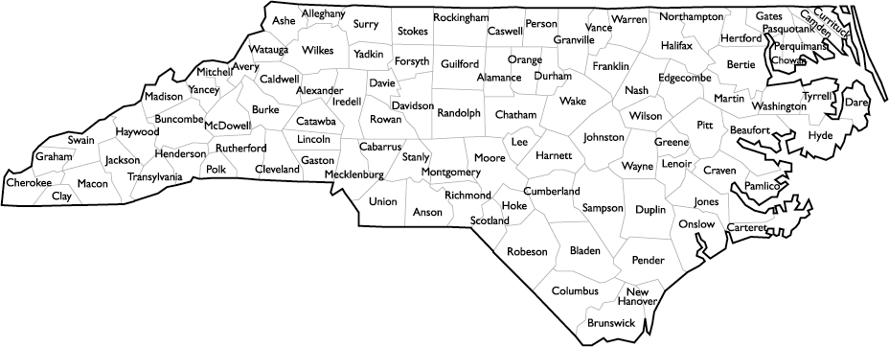
Significant opportunity for local govts
ARPA funds as a share of 2017 spending
7.2%
7.7%
9.3%
5.9%
5.1%
6.8%
7.0%
7.2%
2.7%
Sources: U.S. Department of the Treasury, U.S. Census Bureau, NASBO

Slide 3
Permissible uses
Mitigate health, economic impacts of COVID-19
Address pandemic’s disparate impacts on certain populations and geographies
Build infrastructure
Support essential workers
Expanded eligibility with documented revenue loss

Slide 4
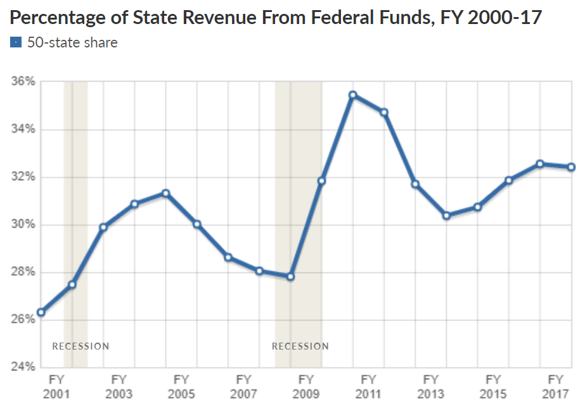
Beware the risk of the “fiscal cliff”
Lessons learned from the Great Recession

Slide 5
3 key principles for allocating funds
Think long term, mitigate risk, prioritize one-time use
Plan for the future: Analyze revenue and expenditures over the long-term, and plan for a range of post-ARPA scenarios
Mitigate risk: Be cautious about using one-time stimulus funds for ongoing programs, risking structural budget gaps
Prioritize one-time use: Consider spending federal funds on programs experiencing a temporary increase in demand which may abate after pandemic

Slide 6
Local govt plans for ARPA funds
Proposals suggest differing interests, some themes
Fairfax County, VA: Investments in behavioral health initiatives, assistance to retail establishments and arts organizations, and supporting IT projects
El Paso County, CO: Money for economic and workforce development, testing and quarantine costs, and water infrastructure upgrades
King County, WA: Rental assistance, vaccination efforts, and covering county operations

Slide 7
Adam Levin
Officer, state fiscal health
alevin@pewtrusts.org

