Slide 1
Pre-Arrest Diversion
Melissia Larson, Law Enforcement Programs Manager
North Carolina Harm Reduction Coalition
The North Carolina Harm Reduction Coalition (NCHRC) is a statewide grassroots
organization dedicated to the implementation of harm reduction interventions, public
health strategies, drug policy transformation, and justice reform in North Carolina

Slide 2
Sequential Intercept Model
Notes:
The Sequential Intercept Model outlays the structure of the CJ system. This diagrams indicates intercept points in which individuals with mental health and/or substance use disorders can and should be diverted from the traditional CJ system and into one that takes a behavioral health approach.
Intercept #1 is for pre-arrest diversion programs, Intercept #2 focuses on post arrest, Intercept #3 operates within the court/jail, Intercept #4 looks at re-entry programming, and Intercept #5 focuses on probation/parole. Examining each intercept points with key local stakeholders provides an opportunity to divert individuals from the punitive criminal justice system, create equity, and connect people with community-based resources who can address their unique needs in a person-centered way. One area in which there is a lot of interest and work going on is Intercept #4, which recognizes that individuals released from the jail who have a SUD are at high-risk of overdose and face challenges obtaining treatment unless linkage to care strategies are in place prior to exit.
During this webinar, we will be specifically talking about Intercept #1, where pre-arrest diversion programs are implemented. An outcome of diversion, which precedes charging, is that participants can avoid the stigma of a criminal record entirely. We all know the challenges the justice-involved population faces in obtaining house and employment; key determinants of health.
If your community has not yet completed a sequential intercept mapping process, I highly recommend it. It is a great opportunity to bring stakeholders to the table to identify current resources while identifying gaps/challenges. It is a collective effort which can have high impact on your overall criminal justice and behavioral health system. Google: samhsa gains center

Slide 3
Example of Pre-Arrest Diversion (Intercept 1): LEAD Program
LEAD (Law Enforcement Assisted Diversion) is a pre-arrest diversion program that utilizes officer discretion to divert low level drug offenders and sex workers from the traditional criminal justice system and link them into treatment. This linkage to services operates within a harm reduction framework to include intensive case management and peer support services.
Notes:
LEAD is a pre-arrest aversion program that utilizes officer discretion to divert low-level drug offenders and sex workers from the traditional criminal justice system. The program provides a harm reduction approach to community-based issues of substance use, mental illness, criminal justice system involvement, and social conditions. Pre-arrest diversion allows police officers at the point of contact to divert offenders with behavioral health issues away from the criminal justice system and into long term intensive case management services based on a harm reduction philosophy. As more and more agencies are realizing the use of the traditional criminal justice is not appropriate or effective in addressing behavioral health issues, we are seeing the development of pre-arrest diversion programs.
Diverted individuals receive a ‘warm hand off” into wrap around services such as drug treatment, emergency housing, mental health treatment, peer support, and vocational training.
Benefits include redirecting officers back to the street to handle more pressing law enforcement priorities, reducing cost savings to social service and medical systems, and reducing drug related injuries to include overdose deaths, spread of communicable diseases such as HIV & Hep C, abscesses, etc.

Slide 4
Application of the LEAD Program
Originally designed to address racial disparities in drug arrests
Address the negative impact of mass incarceration on individuals and communities
Address valid business and neighborhood concerns about health and safety
Reduce harmful impact of criminalization on the marginalized populations within the sex trade continuum
Help communities respond to public order issues stemming from unaddressed public health and human services needs -- addiction, untreated mental illness, homelessness, and extreme poverty
Source: LEAD National Support Bureau www.leadbureau.org
Notes:
Communities have implemented their LEAD program based on different individualized needs. Some communities have implemented their program prioritizing their focus on reducing racial disparities and drug arrests, other have sought to reduce property crime associated with drug use, some focus on addressing public health and human services needs, while others have created their program to address business and neighborhood concerns about health and safety. In most communities this is about doing something different; recognizing that previous strategies have not been effective in addressing these issues and conditions. While the name may be Law Enforcement Assisted Diversion, this program is much more about one particular stakeholder. It’s about bringing together public health & public safety officials, treatment providers and directly impacted people for a common goal of improving the quality of life for people who use drugs and reducing the impact on and from the criminal justice system. It is important to note that LEAD programs should create equity be addressing all substances and not simply focusing on opioids.

Slide 5
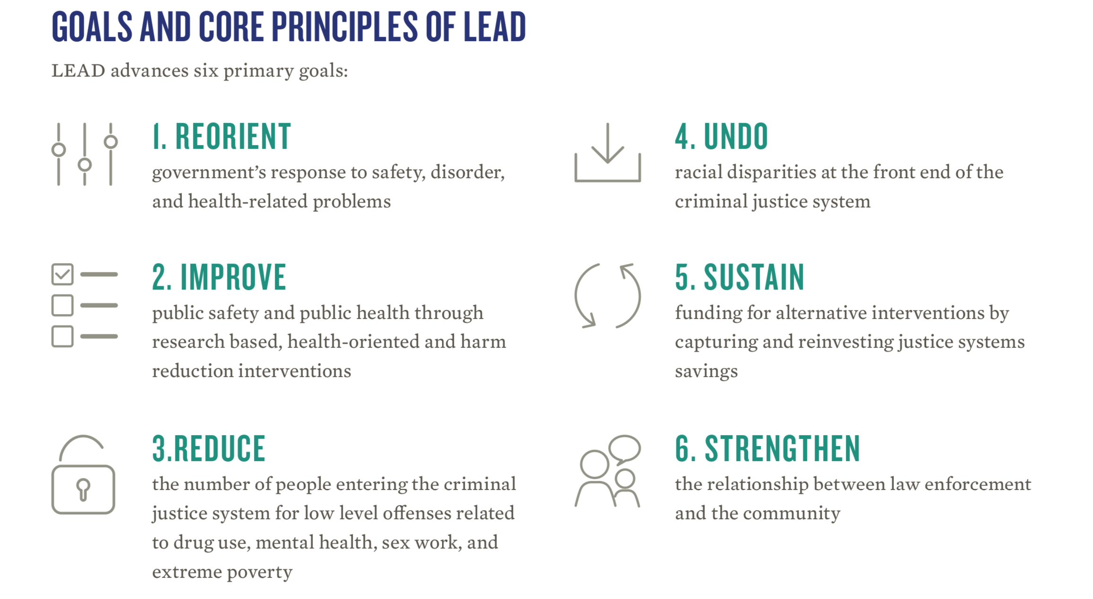
Source: LEAD National Support Bureau www.leadbureau.org
Notes:
The LEAD program has two overarching goals: one is to reduce criminal justice involvement and the other is to improve access and increase engagement in treatment and harm reduction services.
The use of evidence-based practices can lead to a reduction in criminal justice involvement while removing racial disparities within the criminal justice system and focusing on the social detriments of health. This focus can help communities sustain funding for more effective interventions while strengthening the relationship between public safety and the community. It is important for us to realize that drug use, due to its criminal nature, has resulted in people being stigmatized for their health conditions and has also resulted in adversarial relationships between law enforcement and people who use drugs. Implementing pre-arrest diversion programs allows systems and communities to reorient traditional responses to one that utilizes local partnerships and resources in a collective way.

Slide 6
Intercept 1: Pre-Arrest
LEAD is a program built upon partnerships with stakeholders within the community; to include the District Attorney’s Office, the local treatment providers, LME/MCO’s, and harm reduction/peer support partners.
LEAD is not about creating entirely new programs; it is about bringing existing stakeholders together who have a common goal of reducing crime and connecting people with substance use disorders to treatment and supportive services.
Provides a warm hand-off to local treatment and supportive services
Notes:
What’s great about LEAD is the collaboration of existing stakeholders willing to come to the table to do something different. This program brings together treatment providers, law enforcement, the district attorney’s office, the LME/MCO, and harm reduction/peer support partners. LEAD does not require building an entirely new program; it is about bringing existing stakeholders together who have a common goal of reducing crime and connecting people with substance use disorders to treatment and supportive services.
Operating within a harm reduction framework, LEAD recognizes no one size fits all; everyone is on their own journey; we need to meet people where they are. There are no compliance guidelines or sanctions for participants. We believe in attempting re-engagement in services, not punishment. The LEAD program also recognizes that not everyone is treatment ready at the time of interaction with law enforcement. This is a new conversation between officers and people with a substance use disorder. But for those that are ready, the program is structured in a way that provides the referring officer a process in which to conduct a warm hand-off to a case manager.

Slide 7
Intercept 1: Pre-Arrest
The overarching goals of pre-arrest diversion are to address behavioral health needs within a community-based model versus within the traditional criminal justice system.
LEAD sites experience at least a 60% reduction in criminal justice involvement among their participants as they engage in treatment and supportive services available to them through the program.
Participants have a higher level of engagement in treatment and/or supportive services. The value of peer support ☺
Notes:
I think we can all agree the criminal justice system was never intended to be therapeutic; yet we’ve continued to process people with underlying behavioral health issues through it, expecting significant change in their drug use and criminal justice involvement.
We have two broad goals within the LEAD program; decrease crime-related activity and increase access to treatment and supportive services. We have seen successes within our NC LEAD sites. Prior to COVID19 sites were seeing an 80% reduction in criminal activity among participants, since COVID19 this has reduced; yet still a significant decrease in crime. Additionally, we have seen participants re-engage in services they had previously used; from harm reduction to more traditional treatment services.

