Slide 1
HIGHER
QUALITY DELIBERATIONS

Slide 2


Samuel R. Sommers & Phoebe C. Ellsworth, How Much Do We Really Know About Race and Juries? A Review of Social Science Theory and Research, 78 Chi.-Kent L. Rev. 997 (2003); Samuel R. Sommers, Determinants and Consequences of Jury Racial Diversity: Empirical Findings, Implications, and Directions for Future Research, Social Issues and Policy Rev., V. 2., No. 1, pp. 65-102; Samuel R. Sommers, On Racial Diversity and Group Decision Making: Identifying Multiple Effects of Racial Composition on Jury Deliberations, J. Personality & Soc. Psych., V. 90, No. 4, pp. 597-612 (2006) .

Slide 3



DIVERSE JURIES
Deliberate longer
Discuss more case facts
Fewer factual errors
More likely to correct factual errors
More statements about race

Slide 4
White jurors

Slide 5
LESS
BIASED OUTCOMES

Slide 6
785 felony trials
Shamena Anwar, Patrick Bayer, Randi Hjalmarsson, The Impact of Race in Criminal Trials, The Quarterly Journal of Economics, 1-39 (2012)

Slide 7
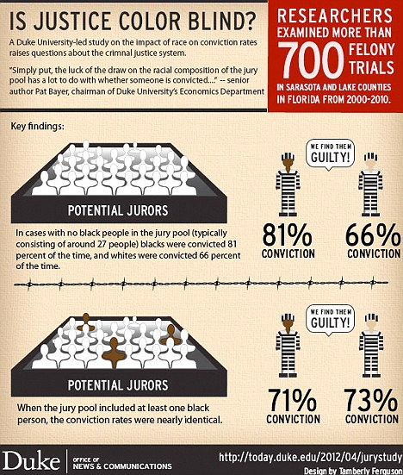
Jury drawn from all-white jury venire
785 felony trials
Jury drawn from venire with at least one black person

Slide 9
INCREASES PUBLIC CONFIDENCE

Slide 10

Jury diversity
Public confidence

Slide 11


FAIR
UNFAIR
Leslie Ellis & Shari Seidman Diamond, Race, Diversity, and Jury Composition: Battering and Bolstering Legitimacy, 78 Chi.-Kent L. Rev. 1033, 1049 (2003)

Slide 12
ACQUITTED
CONVICTED
Racially mixed jury = any outcome is seen as fair
✔
✔

Slide 13
✔
ACQUITTED
CONVICTED
All white jury = convictions are seen as less fair

Slide 15
 | No Photo ID
White | 5%
Black | 13%
Hispanic | 10%
Vanessa M. Perez, Ph.D., Americans with Photo ID: A Breakdown of Demographic Characteristics, 6, Project Vote (Feb. 2015)

Slide 16
 | No Photo ID
Less than $25,000 | 12%
More than $150,000 | 2%
Vanessa M. Perez, Ph.D., Americans with Photo ID: A Breakdown of Demographic Characteristics, 6, Project Vote (Feb. 2015)

Slide 17
DRIVERS LICENSE HOLDERS
STATE ID HOLDERS
Neeley, Elizabeth M., "Representative Juries: Examining the Initial and Eligible Pools of Juries" (2011).
Publications of Affiliated Faculty: Nebraska Public Policy Center. 22.

Slide 18
UNDER-REPRESENTATION
UNDER-REPRESENTATION OF BLACK COMMUNITY
16.1 %
1.8 %
Neeley, Elizabeth M., "Representative Juries: Examining the Initial and Eligible Pools of Juries" (2011).
Publications of Affiliated Faculty: Nebraska Public Policy Center. 22.

Slide 20

Black homeownership rate in North Carolina
White homeownership rate in North Carolina
47%
75%
Annie Baumann-Mitchell, The Black-White Home Ownership Gap in North Carolina, North Carolina Housing Finance Agency (June 16, 2021)

Slide 21
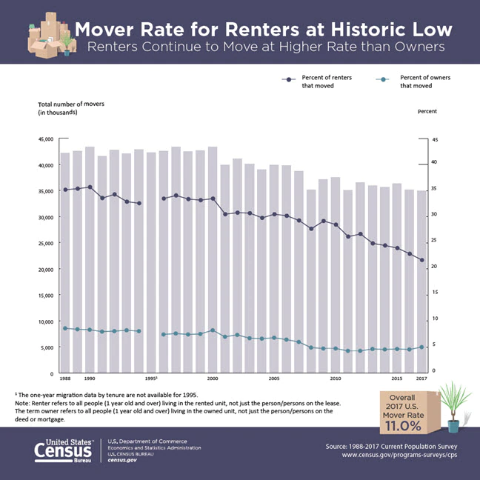
Moving rate for RENTERS
Moving rate for OWNERS
2017, U.S. Census Bureau

Slide 22
Derrick Moore, U.S. Census Bureau, Overall Mover Rate Remains at an All-time Low (Dec. 21, 2017)

